Slide 1
Hollow Vertices
Norah Lorway

Slide 2
Page 2
Page 3
Page 4
Page
Page

Slide 3
Key dates
Role
Funders
Partners
Collaborators/ key people

Slide 4
Hollow Vertices is an improvisatory audio-visual performance environment. The piece was created by Norah Lorway, who lives code during the performance, Kiran Bhumber on clarinet and Nancy Lee who VJs throughout the performance.
The sonic components are co-created through live coding in the real-time audio synthesis language, Supercollider. This results in the creation of dense percussive and ambient textures. The two sound sources are linked through a custom built network upon which each performer has control over the others’ code. This produces developmental elements in the composition. This is combined with an amplified clarinetist using a custom programmed pedal board in Max/MSP to drive live audio effects.
A projected image is displaying the sound source’s live-code, framed by another projection of video content manipulated in real-time through an internal video feedback process programmed in CoGe VJ. The video feedback is processed by custom-built effects that transform the content into new video feedback abstractions. Effects are programmed so unpredictable visual outcomes or glitches appear. The visual glitches aid in the transitional process between visual aesthetics during the performance. Some visual effects are programmed to interact rhythmically with the composition, and some are manually controlled as the piece is improvised.
The composition converges disciplines and mediums by augmenting sensorial modalities through human-computer interaction. This is realized through employing different programming languages, combinations of instruments, and reacting to the collective output while maintaining awareness of individual contributions to the composition.
Hollow Vertices was premiered at Vivo New Media Center in Vancouver British Columbia, Canada in 2015. It has had subsequent performances at the International Conference on New Musical Interfaces in Brisbane, Australia in 2016, a tour of Asia in 2016, Toronto Electroacoustic Symposium, Canada in 2016 and finally the International Conference on Live Coding in Hamilton Canada, 2016.

Slide 5
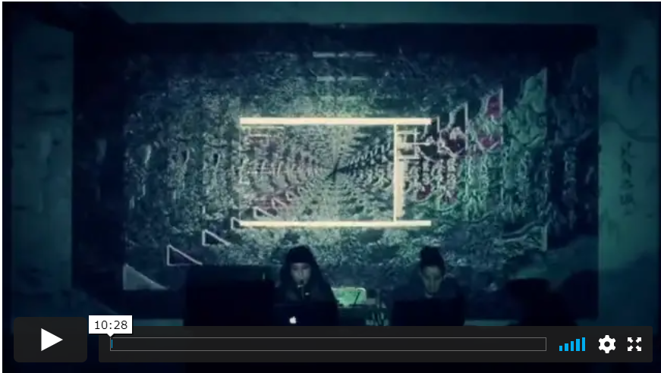
Hollow Vertices
https://vimeo.com/460114522/e459f5839f
Running time: 10:28

